Slide 1
PROPOSAL FOR JOINT CLARKSON HYDE GLOBAL & CICERO LEAGUE OF INTERNATIONAL LAWYERS CONFERENCE
Autumn 2022: Vilnius - Lithuania

Slide 2
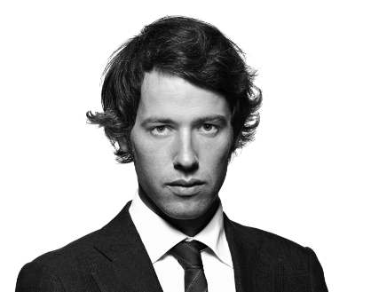
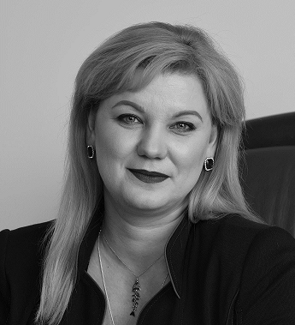
A STRONG COOPERATIVE COUNTRY FOR CHG & CICERO
LITHUANIA
CICERO LITHUANIA RECRUITED CHG LITHUANIA FOR CHG
WE WORK TOGETHER ON MANY CLIENTS
WE NETWORK TOGETHER REGULARLY – ADDITIONALLY OFFERING JOINT CONSULTATIONS FOR NEW CHAMBER MEMBERS IN VILNIUS
CHG LITHUANIA REGULARLY PARTICIPATES IN CICERO CONFERENCES AND IS KNOWN TO ITS MEMBERS

Slide 3
CONCEPT: INCORPORATING A BUSINESS FACING EVENT
FOR BUSINESS OWNERS:
DID YOU EVER DREAM OF HAVING YOUR OWN BUSINESS OUTSIDE OF YOUR LOCAL MARKET?
DID YOU EVER DREAM OF EXPANDING YOUR BUSINESS ON A GLOBAL LEVEL?
IF YOUR ANSWER IS YES, THEN:

Slide 4
OUR FIRST INTERNATIONAL BUSINESS EVENT
JOIN CLARKSON HYDE GLOBAL AND CICERO LEAGUE OF INTERNATIONAL LAWYERS FOR ADVICE & FREE CONSULATIONS ON:
TAX, REGULATORY AND
LAW ISSUES
DIRECTLY FROM INTERNATIONAL PROFESSIONALS - ALL IN ONE PLACE

Slide 5
MORE THAN
*1600 PROFESSIONALS FROM 45
COUNTRIES
REPRESENTED IN VILNIUS 2022
*Guesstimate based on doubling CHG’s employee figures. We can update with accurate figures for Cicero

Slide 6
THE EVENT
COME AND MEET LAWYERS AND ACCOUNTANTS TO ASK YOUR QUESTIONS:
More than 50 professional lawyers, accountants, auditors and tax consultants available for one-to-one consultations.
More than 1600 team members globally who can help you to spread your business in our represented countries.

Slide 7
VALUE FOR OUR MEMBERS
IF THE BOARDS OF BOTH NETWORKS APPROVE THE IDEA IN PRINCIPLE:
We will require one extra afternoon before the conference – beginning before the welcome dinner?
Cicero and CHG joint budget for the marketing of the event including securing a guest list through chamber of commerce and other business network promotion, Avocad and Inova Experts client promotion, social media promotion and so on plus half day conference room hire and light refreshments for guests. Should not be huge.
Each member firm sends an attendee to the event and conference who is prepared to provide commercial consultation, if required.
Additional value from the event: registration will allow us to see which markets businesses are interested in. Based on this info, we can create value by working closer together, making joint projects with members from interested countries.
A pilot to possibly continue with similar events at each of CHG’s and Cicero’s annual conferences.
A low cost promotional exercise for both CHG & Cicero to get the most from our joint conference.
A fantastic networking opportunity for members of both networks, where it is really highlighted how well local members can work together.

Slide 8
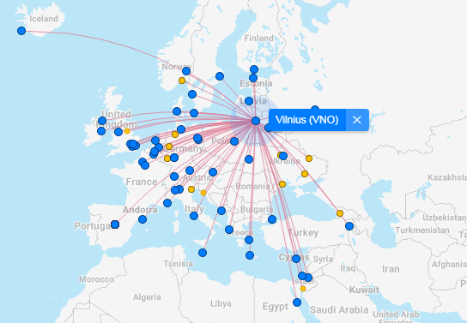
ABOUT VILNIUS
Non-stop flights from Vilnius (VNO)
Vilnius International Airport, is the largest airport in Lithuania. Vilnius Airport has non-stop passenger flights scheduled to 64 destinations in 31 countries.

Slide 9
LOW COST CITY FOR INTERNATIONAL VISITORS
Hotel rooms are typically lower to rent than in other European cities so we would anticipate a good price for the conference booking. Typical price for a 5* hotel: 120 eur
The cost of eating out and drinking is also considerably lower. Typical price for dinner with wine: 25 eur/person
1 pint of beer = 2,5-3 eur
Vilnius is a small and beautiful city with many wonderful attractions for social excursions.

Slide 10
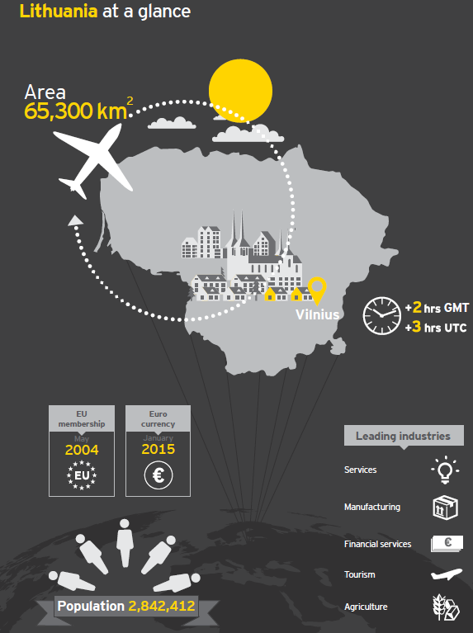
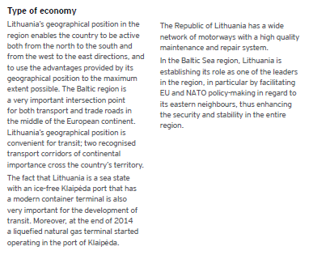
Data source: EY 2018

Slide 11
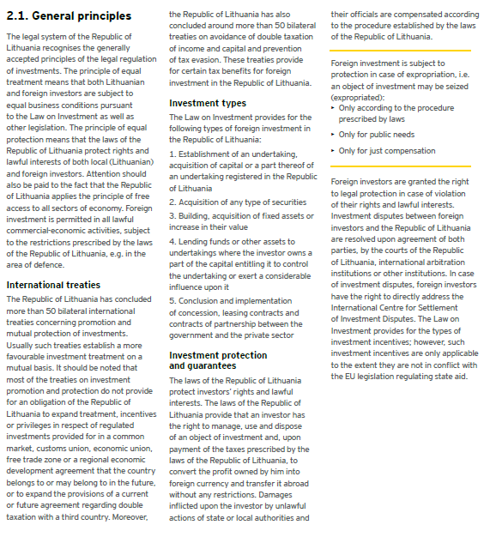
Data source: EY 2018

Slide 12
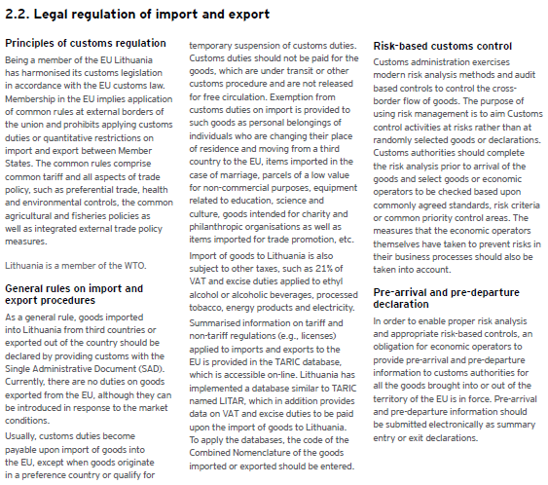
Data source: EY 2018

